Slide 1
The UK Education System & Pathways to Oxbridge & G5 Universities

Slide 2
Why Study in the UK?

Slide 6
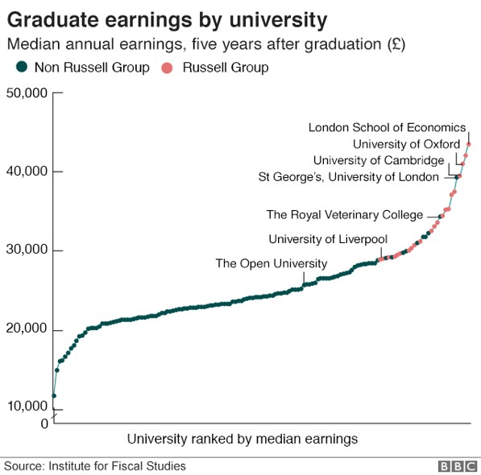

Slide 7
Extension & Enrichment Programme
Oxbridge, G5, & Medicine Applications

Slide 8
What are Oxford & Cambridge looking for?
“I think the common denominator that I find at Oxford is the ability to think deeply... It's the ability to look at anything - whether it's a newspaper article, a piece of research or an object - and instinctively start considering the theory behind it, the potential impacts on a wider level, your own position and thoughts about it, what other people might think... It's the ability to absolutely refuse to take things at face value.”
Head of Admissions, Oxford University
Academic Results
Depth of Knowledge
Breadth of Knowledge

Slide 9
Is Oxford or Cambridge the right university for me?
Cambridge & Oxford will only accept students with top academic results
Only 20% of applicants successfully obtain a place at Oxbridge
90% of successful applicants to Oxford achieve a minimum of A*AA at A-Level
40% of successful applicants to Oxford achieve A*A*A* or better at A-Level
97% of successful applicants to Cambridge achieve a minimum of A*AA at A-Level
60% of successful applicants to Cambridge achieve A*A*A* or better at A-Level
Students applying to Oxbridge will usually need to sit additional tests, submit written work, and attend an interview
Studying at Oxford & Cambridge can be an intense, stressful and pressurised experience.

Slide 11
What do successful applications have in common?
Hard-work
Determination
Excellent Grades
In depth subject knowledge
Luck
“I find that the harder I work, the more luck I seem to have.”
Thomas Jefferson

Slide 12
Understanding the application process
WHEN | WHAT
Year 11 | All year | Work hard to achieve the best possible GCSEs/ Equivalent - you need A/A* grades for Oxbridge
 | Summer | Finalise your A level options, bearing in mind that you need to achieve high grades and that Oxbridge prefer the facilitating (traditional academic) subjects
Year 12 | January | Choose your degree course
 | January onwards | Read extensively about your chosen subject, making notes as you do so
 | January onwards | For vocational courses in particular, organise relevant work experience
 | June | Sit AS examinations, or internal end of year 12 examinations
 | June | Start drafting personal statement
 | June/July | Attend Oxford and Cambridge Open Days, decide where to apply

Slide 13
Understanding the application process
WHEN |  | WHAT
Year 13 | September | Finalise personal statement and UCAS form
 | September | Register for admissions tests
 | October | Send application
 | October | Cambridge applicants only: complete supplementary application questionnaire
 | October/November | Prepare for interviews and entrance tests
 | November | Receive notification of invitation to interview
 | November | Submit examples of written work, if required
 | November | Sit pre-interview admissions tests, if required
 | December | Attend interview (including sitting at-interview admissions tests, if required)
 | January | Receive decision from Oxbridge
 | March | Receive decision from all other universities
 | May | Respond to universities on UCAS, indicating firm and insurance choices
 | June | Take A level examinations

Slide 14
Early Preparation- Middle School
When: Year 11
Do:
Work Hard,
Achieve consistent results across all subjects,
Begin nurturing an academic interest in your favourite subjects.
Don’t:
Think that universities make offers based only on A-level predictions
Things to do
Read International & British Newspapers
Listen to Podcasts & Lectures online
Begin to read around your subject, look out for easily accessible journals & magazines: Science Daily, National Geographic, Smithsonian, Wall Street Journal, The Economist, History Today etc.
Successful applicants typically have a high proportion of A & A* Grades… higher grades can help to make your application more successful.
University of Oxford

Slide 15
Choosing Your School/College and A-Level Subjects
When: Summer Years 11-12
Do:
Choose ‘facilitating’ subjects,
Choose Subjects you like & are good at, ask for advice.
Choose subjects that naturally support each other (Humanities vs Science).
Don’t:
Choose subjects that you have struggled with at GCSE.
Choose subjects just because they have a reputation for being easy.
Choose more subjects than necessary.
Things to Consider
Facilitating Subjects
Personal Interests and Skills
Complimentary Subjects
Transferable Skills
University Entry Requirements
“By choosing facilitating subjects at advanced level, you will have a much wider range of options open to you at university.”
Russell Group Informed Choices Brochure

Slide 16
Enrichment Programme
Successful applicants to Oxford and Cambridge have a broad range of knowledge across many subject areas. The Enrichment programme aims to:
Expose students to new ideas
Help students to understand their subjects in a wider context
Inform students about future careers and pathways
Examples of available presentations
Medicine & Science at G5, Oxford & Cambridge University
Future of Computing- Quantum Information Processing
The Beauty of Mathematics
Oxford & Cambridge University Entrance & Admissions
Dangers & Opportunities of Nuclear Energy
Spread & Prevention of Diseases

Slide 17
Extension Programme
"We're looking for students who are intelligent - very interested in their subject and who can demonstrate their interest“
Mike Nicholson - Oxford University, Head of Undergraduate Admissions
Designed by an array of Cambridge & Oxford Professors & Admissions Staff the Extension Programme provides one-to-one tutorials focusing on five crucial aspects of your application:
Academic Performance
Subject knowledge
UCAS Applications
Entry Tests
Interview Preparation

Slide 18
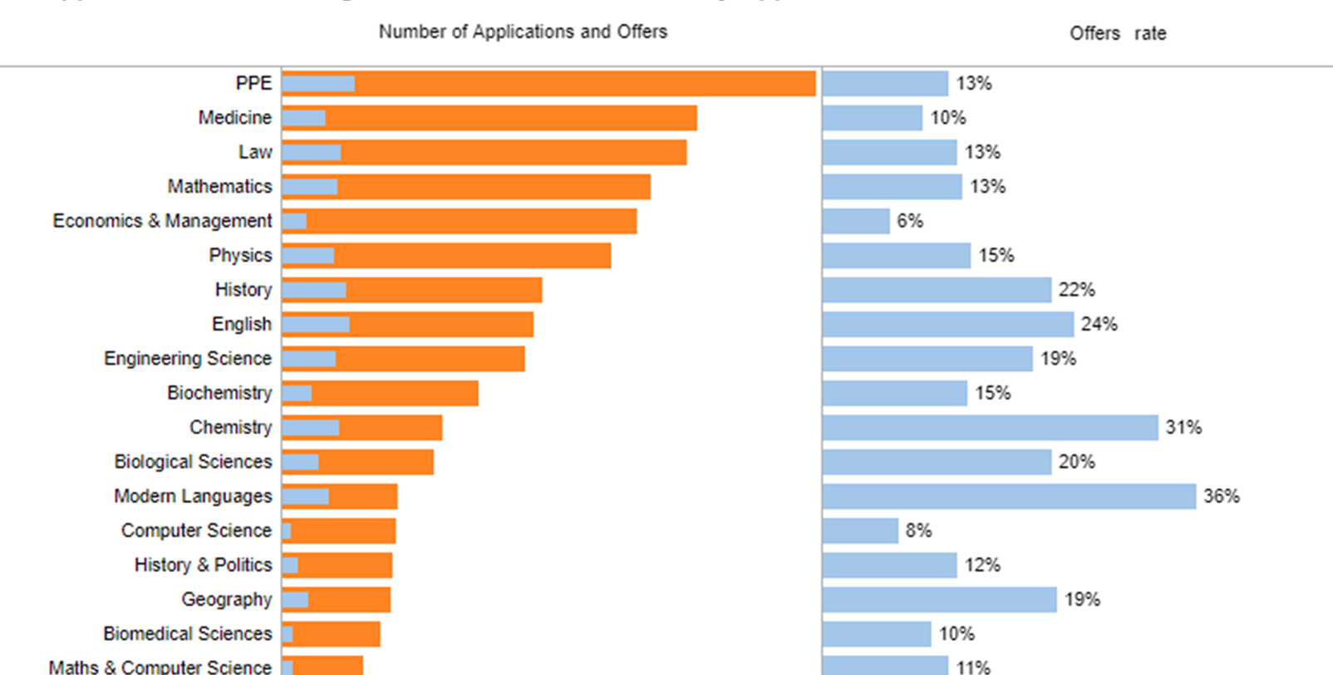

Slide 19
Wider Reading
Reading is an absolutely essential form of preparation. You need to read widely and in-depth. Knowing the school syllabus is not enough. You should be able to think and talk about ideas beyond the scope of school work and above the level of your peers.‘ Dr Sean Buckley
It is crucial to carry out wider reading. Over the course of The Extension Programme you’ll be taught how to approach academic material, to read reflectively, and to formulate your own opinions.
WHEN? | Year 12 from January onwards (two years before you intend to begin university)
DO | Seek advice from tutors, be a reflective reader and make notes as you learn. Enjoy the process and only read what interests you.
DON’T | Try to get through as many books as possible- quality is more important than quantity. Allow extended reading to distract from your grades.

Slide 20
Essay Competition & Prizes, and Extended Projects
“Competitions play a role in motivating students to perform and excel and offer a lot more reward than just the winning prize. Competitions offer a chance for participants to gain substantial experience, showcase skills, analyse and evaluate outcomes and uncover personal aptitude. Competitions also encourage students to adopt innovative techniques and develop their ideas and skills.”
Good University Guide
When?: Year 12, January onwards (two years before you intend to begin university)
Why: Essay Competitions offer a great way to stand out on your personal statement, as well as providing good talking points for your interview.

Slide 21
Work Experience
When: throughout the year before you apply to university (usually during year 12)
Do: try to get varied experience in more than one place especially if you are applying for a vocational course, keep notes about the experience
Don’t: dismiss anything as “irrelevant”: there will be transferrable skills from everything you do
Key: Medicine, Dentistry, Law, Engineering
“Work experience can add considerable clout to a student’s CV, and if they’re thinking of applying to uni, some professional credibility will look great on their UCAS personal statement.”
UCAS Website

Slide 22
College & University Choice
When?: In the summer of year 12 (to attend an Open Day)
Do: Attend open days, research thoroughly
Don’t: Form opinions based on hearsay
Oxford and Cambridge are unusual in that they are collegiate universities. This means that, as well as choosing which university you would like to apply to, you also need to pick a college at that university.
Different colleges have different characteristics:
Location
Formality
Results

Slide 23
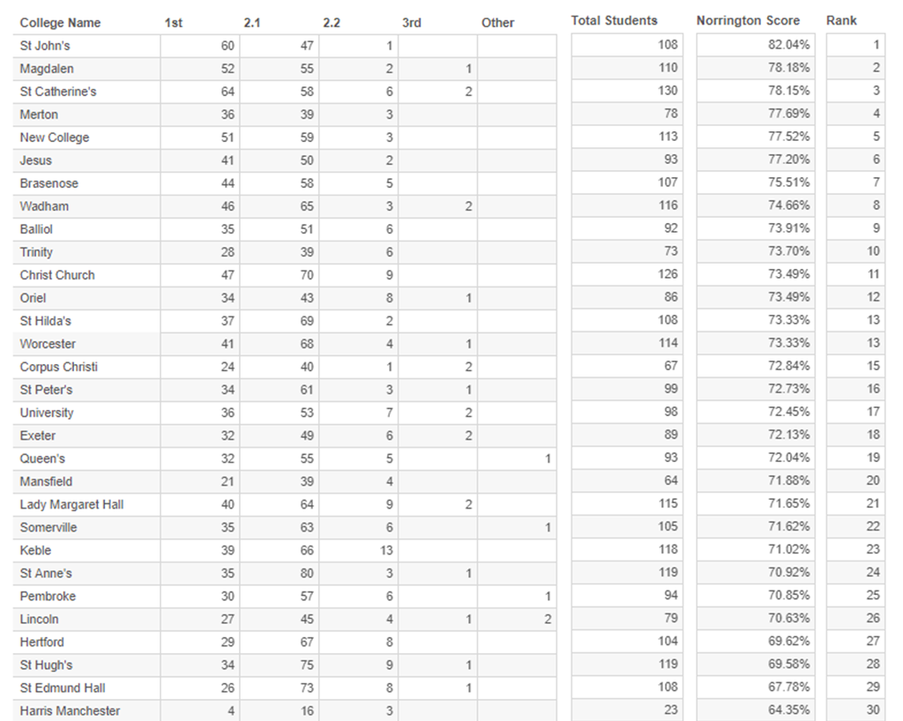
College & University Choice
Tomkins table 2019

Slide 24
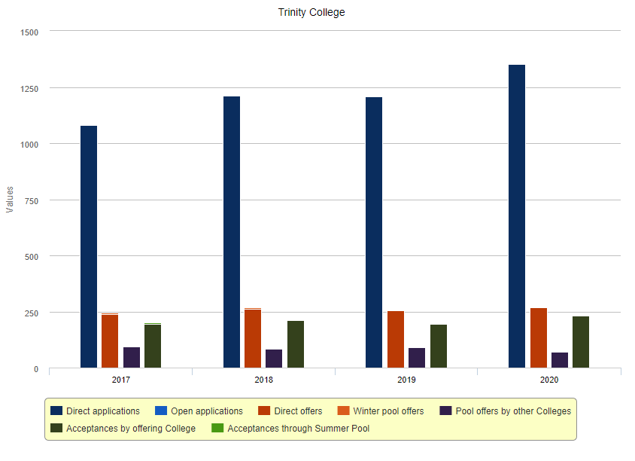
College & University Choice

Slide 25
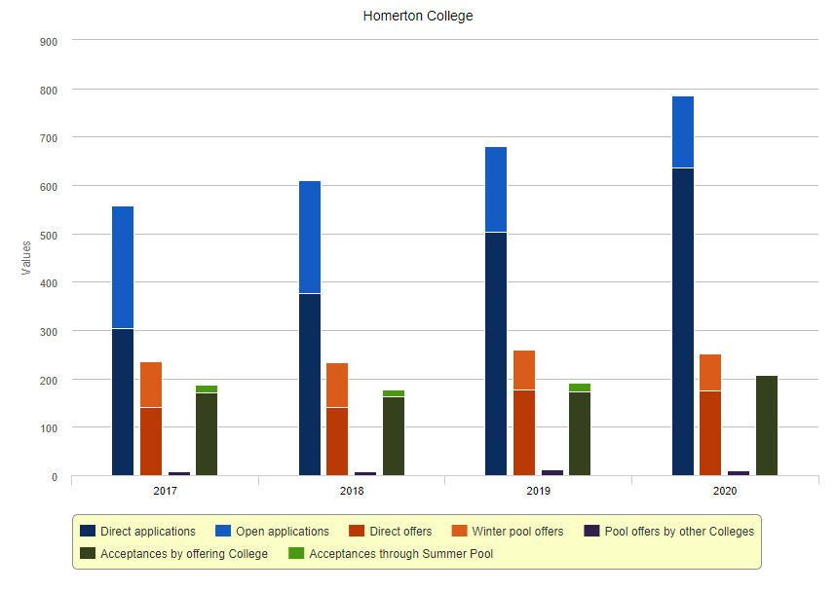
College & University Choice

Slide 26
The Four Big Factors
Personal Statement
Submission & SAQ
Entry & Admission Tests
Written Work
“If people knew how hard I worked to achieve my mastery, it wouldn’t seem so wonderful after all” Michelangelo

Slide 27
Interviews
The programme of mock interviews
INTERVIEW WITH A TEACHER FROM ANOTHER CAMBRIDGE SCHOOL
INTERVIEW WITH PhD STUDENT
INTERVIEW WITH ADMISSIONS PROFESSOR
UNIQUE MOCK INTERVIEW
INTERVIEW WITH ST ANDREW’S TEACHER

Slide 28
Interviews
At interview, the strongest applicants ... showed that they could organise their thinking well, arguing logically, responding positively to challenge, and were able to rethink or refine their initial thoughts on a question when presented with new information, or a different way of approaching it. They were also able to back up their responses with appropriate evidence, drawn from academic sources as well as personal experience... Most importantly, they didn’t give up when presented with something not immediately familiar, but persevered, using their existing knowledge and understanding, to approach an answer.
Dr Sam Lucy, Director of Admissions for the Cambridge Colleges
Tutors are looking for the best-qualified candidates; people whom they will enjoy teaching and who will make a contribution to their academic department. It’s worth reminding yourself what qualities they are looking for in a student.
Dr Sean Buckley, Oxford graduate and author of Getting Into Oxford and Cambridge (2017 Entry)

Slide 29
Interview Question Examples
Does a girl scout have a political agenda? (Law, Oxford)
Are there too many people in the world? Human Sciences at Oxford
I am an oil baron in the desert and I need to deliver oil to four different towns which happen to lie on a straight line. In order to deliver the correct amounts to each town, I must visit each town in turn, returning to my warehouse in between each visit. Where should I position my warehouse in order to drive the shortest distance possible? Roads are no problem since I have a friend who is a sheikh and will build me as many roads as I like for free. Mathematics at Oxford
What was the most beautiful proof in A-Level Mathematics? Mathematics at Oxford
Are humans still evolving? Biological Sciences at Oxford
Make Poverty History is a commendable thought; is it a practical one? Land Economy at Cambridge
What is the difference between buying and selling of slaves and the buying and selling of sports stars? Economics and Management at Oxford

