Slide 1
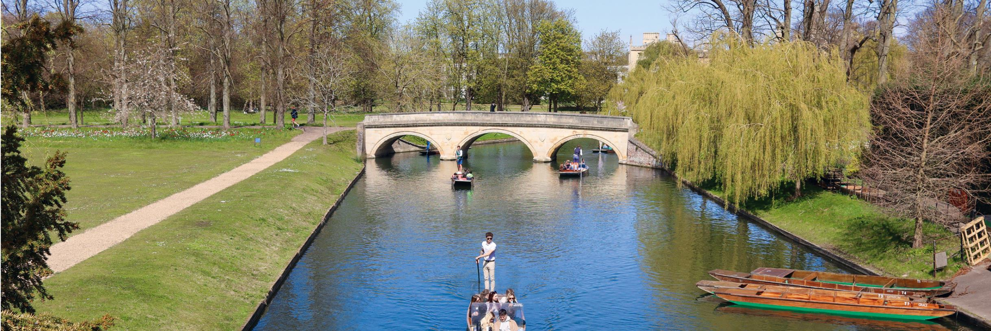
ST ANDREW’S COLLEGE, CAMBRIDGE
Wayne Marshall, Principal

Slide 2
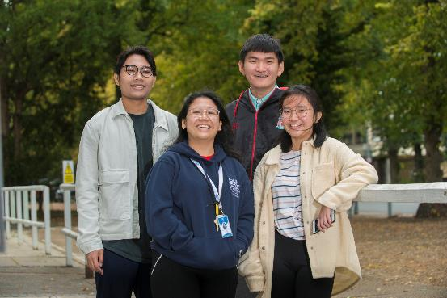
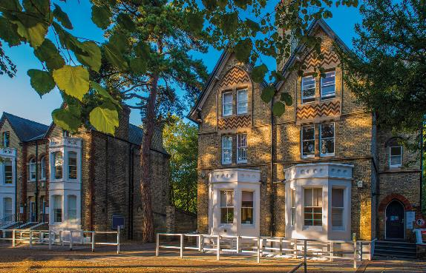
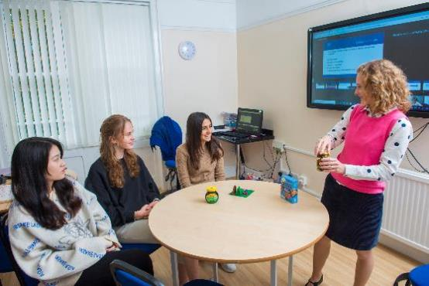
Why St Andrew’s?
Central Cambridge location surrounded by world-famous universities
Top quality teaching staff
Opportunity to attend lectures at Cambridge University
International environment – 18 nationalities in the College
Small class sizes of 6-7 students per class
1

Slide 3
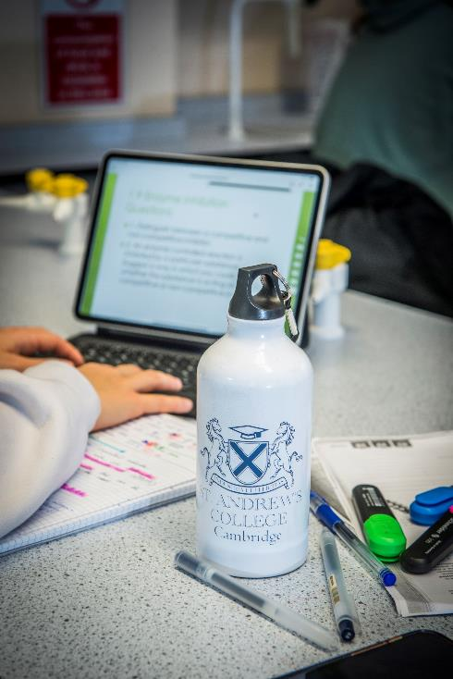

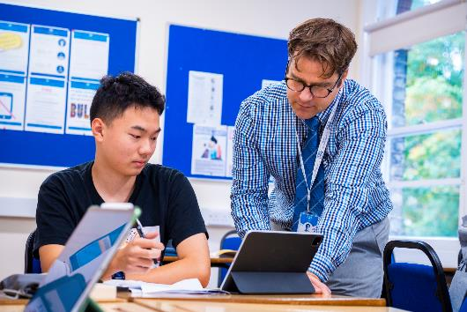
Why St Andrew’s?
Weekly personal tutor support
Carefully monitored student progress
Oxbridge G5 programme with Cambridge University tutors
Extensive UCAS support and university preparation
Excellent pastoral care
Outstanding boarding accommodation
2

Slide 4
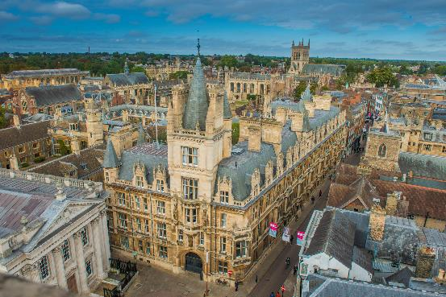
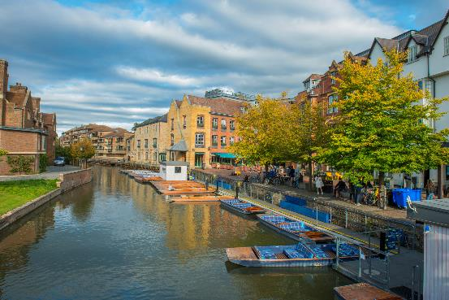
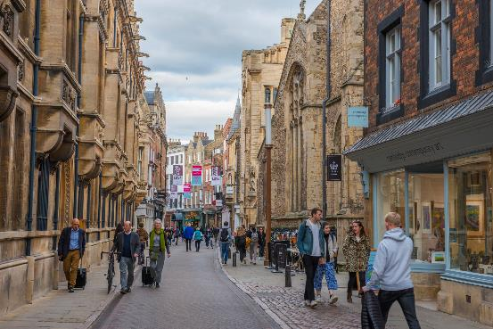
Cambridge
Stunning location
Home to Cambridge University and its 31 colleges
Student-centered city with wide variety of cultural events, entertainment and services
Stunning architecture with River Cam flowing through the city
Great shopping – famous brands and High Street
3

Slide 5
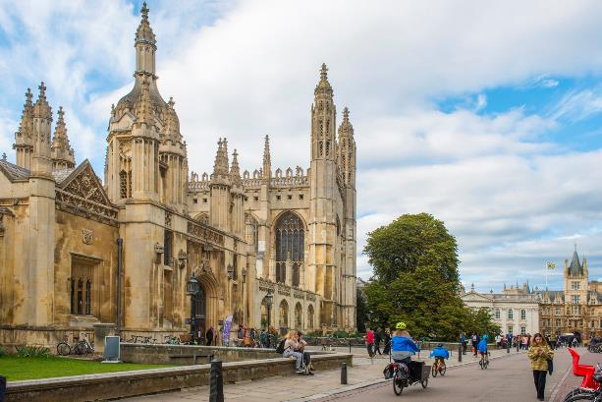
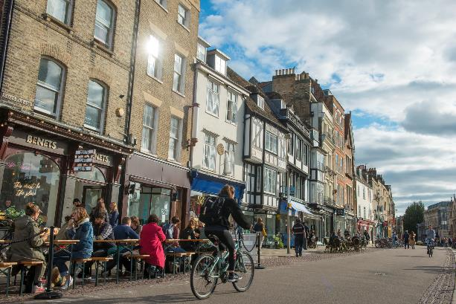
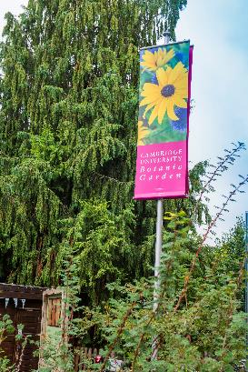
Cambridge
Historical museums, art galleries and theatres
Annual Cambridge University Shakespeare and Science Festival
Numerous sporting opportunities with many sports clubs, gyms and rowing clubs
Numerous parks and open spaces including the stunning Botanical Gardens next to the College
4

Slide 6
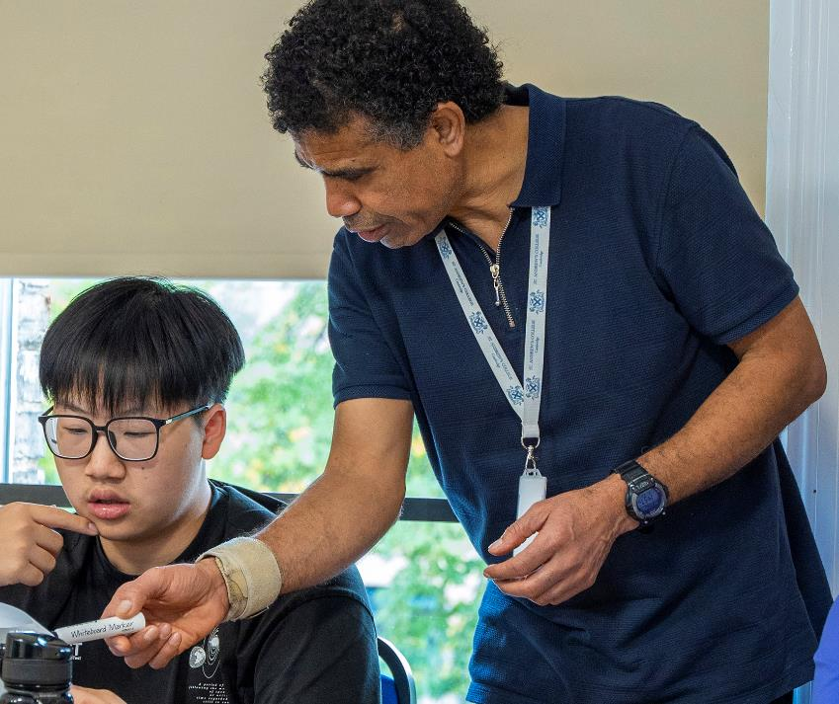
Results 2021
A-Levels
44% A*-A
57% A*-B
100% offered places at UK universities
Foundation
100% offered places at UK universities
100% of Science Foundation students gained places at Russell Group universities
Over 60% gained places at Top 50 universities
5

Slide 7
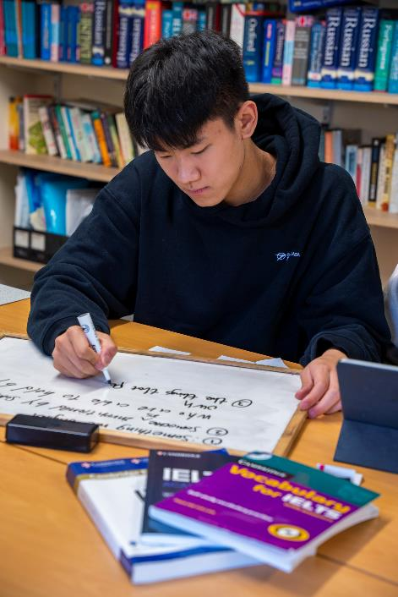
Academic Pathways – Pre A-Level
Alternative to GCSEs providing the opportunity significantly improve English whilst studying academic subjects
15 hours English tuition per week including English for academic purposes
Five hours maths and four hours tuition in each chosen subject in your chosen pathway:
  Business – Business, Economics
  Art – Fine Art, Photography, Fashion and Textiles (2 choices)
  Science –Biology, Chemistry, Physics (2 choices)
September (IELTS 4.0) or January (IELTS 4.5) intake
6

Slide 8
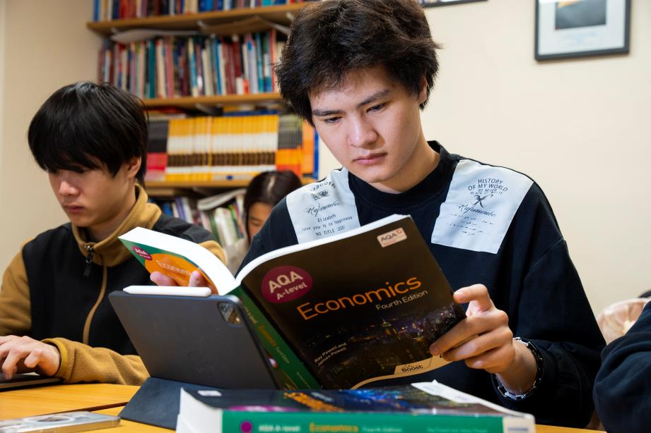
Academic Pathways – A-Levels
16 Subject choices on offer
Most accepted route to UK universities
Accepted qualification for medicine
Small class sizes of 6 or 7 students to a group
Individual attention and support
Weekly tutor sessions
UCAS support sessions
Oxbridge and G5 programme
7

Slide 9
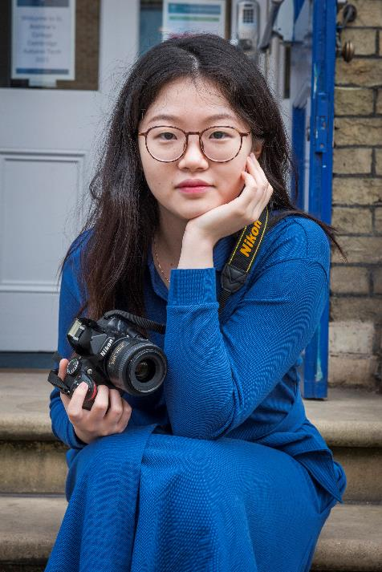
Academic Pathways – University Foundation
Fast, cost effective route to university for students aged 16.5+
January or September start dates
High success rate for international students with IELTS prep built in
Not tied to a specific university
Small class sizes to maximise results
Family-style boarding school environment with excellent academic support and pastoral care – ideal for those away from home for the first time
Weekly personal tutor support and UCAS guidance
Accredited by NCFE
8

Slide 10
Academic Pathways – University Foundation
WIDE RANGE OF COURSES AVAILABLE
Art & Design | Business | Humanities
Architecture | Economics | Science
International Relations | Engineering
9

Slide 11
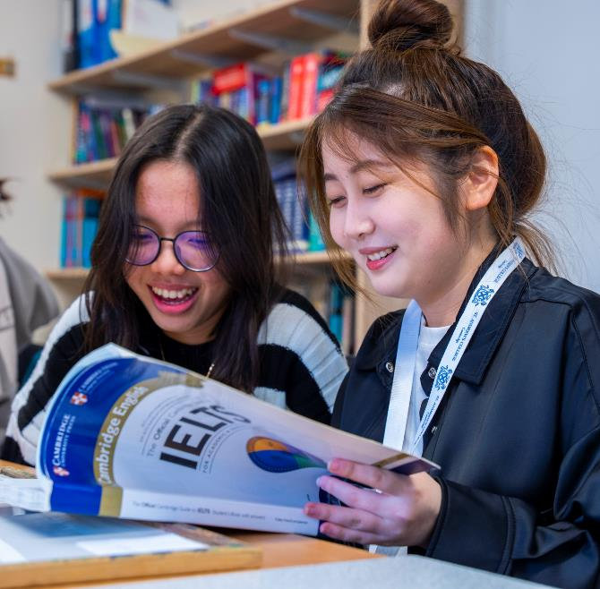
IELTS Preparation
Outstanding IELTS preparation
Individual assessment based on a student’s IELTS level at entry
Reading, writing, speaking, listening
Development of grammar, vocabulary, academic terminology, improve writing styles, gain confidence in speaking and improve listening skills
Half termly testing and regular in-class progress tests
Additional support
Homework to practice what learnt in class and students supported to identify what they need to self-study
10

Slide 12
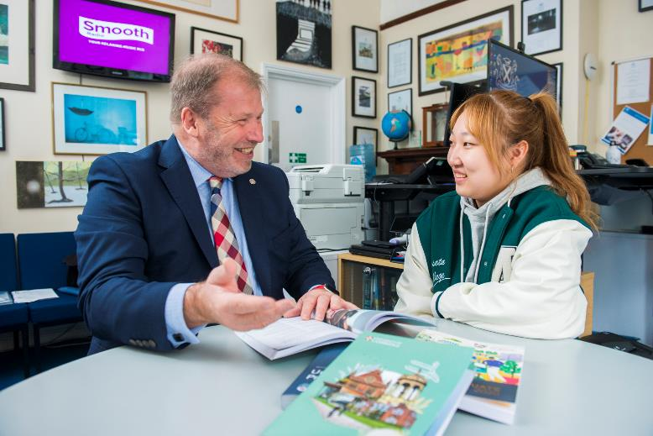
University Preparation
St Andrew’s has excellent connections with university admissions departments
Tailored advice and support for every student through individual and group preparation sessions
Introduction to UCAS
Choosing your course and university
The application process
University Open Days
Interview training
Personal statement
Applying
After Applying
11

Slide 13
Oxbridge and G5 Programme
Specially designed for A Level students wanting to apply to Oxbridge/G5
Designed to give the more able students the additional support and best chance to succeed
One to one tutorials focusing on academic performance, subject knowledge, UCAS applications, entry tests and interview preparation
Work with Cambridge University tutors who have studied the same subject as the student to advise on:
  Specific application criteria for their chosen course
  In-depth view into life at Oxbridge/G5
  Overview of course content and modules
  On the ground view of teaching staff and research
  Share best practice at interview and in writing personal statements
12

Slide 14
Oxbridge and G5 Programme
Provide advice on:
  Choosing your degree
  Wider reading
  Essay competitions and prizes
  Work experience
  Extended projects
  University and Oxbridge College choice
  Personal statements
  Academic excellence
13

Slide 15
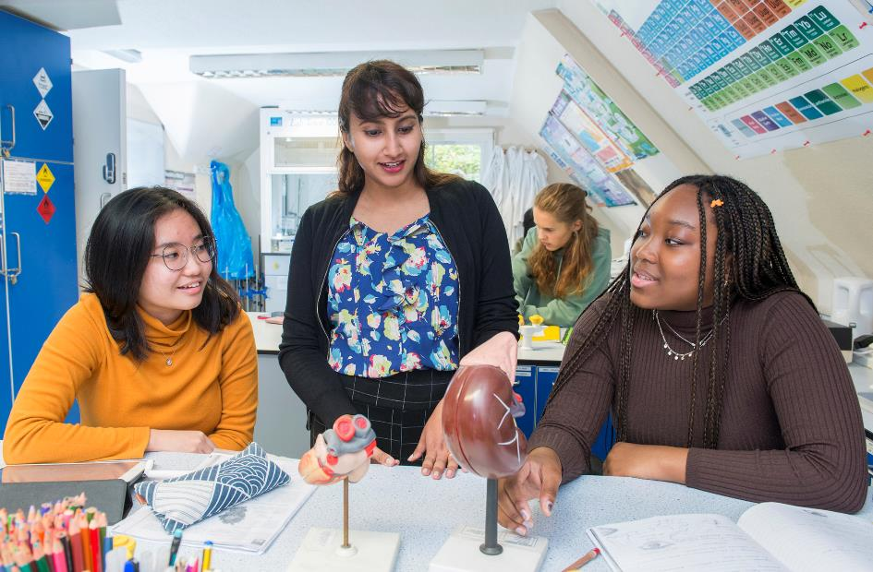
Medics’ Programme
Designed for high-achieving students looking for medicine, veterinary science, pharmacy and dentistry
Must study Biology, Chemistry, Physics and/or Maths
Overview of medicine-related degrees
Requirements for becoming a doctor
The National Health Service
Medical vocabulary
Mock interview preparation
14

Slide 16
Medics’ Programme
Dedicated tutor support to include:
Choosing the degree and completing the application
Personal statement development
Preparation for exams (BMAT, UCAT)
Interview preparation and mock interviews
Volunteering and work experience
Attending medical seminars and arranging visits
15

Slide 17
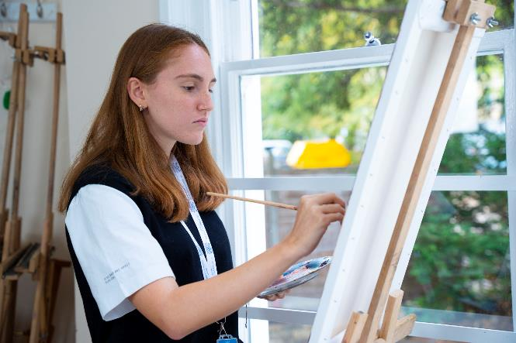
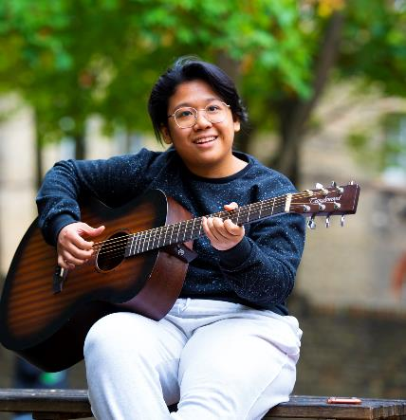

Extra-Curricular
Sports – regular sports activities take place in two sports centres with weekly matches and tournaments
Clubs and Societies including STEM, Student Council, Computer Programming Club, Art Club, Creative Club, Chess Club, Music, Debating, Running, Critical Thinkers, Young Enterprise
16

Slide 18

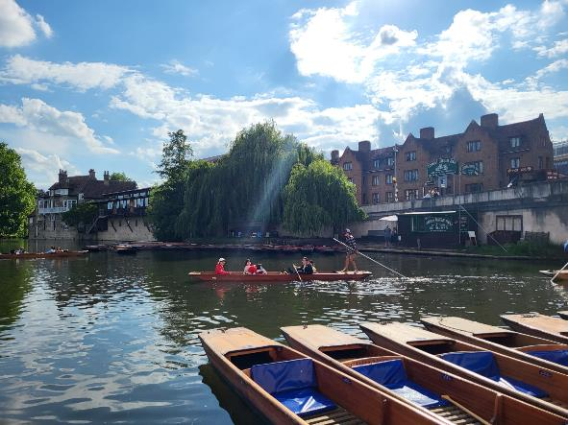
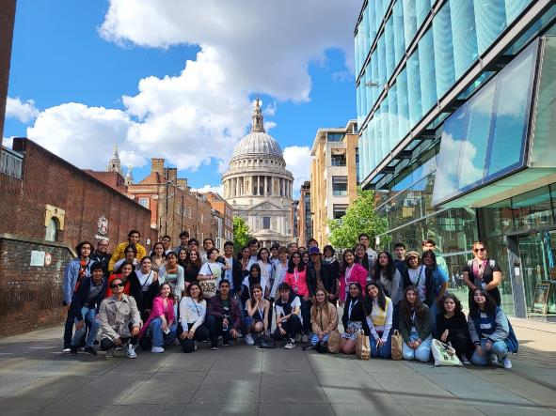
Extra-Curricular
Competitions – creative writing, comic strip, photography, maths and science challenges, student commendations
Social activities – film nights, traditional afternoon tea, games nights, May Ball, punting, museum and gallery visits, festivals and plays, day trips and sports events
17

Slide 19
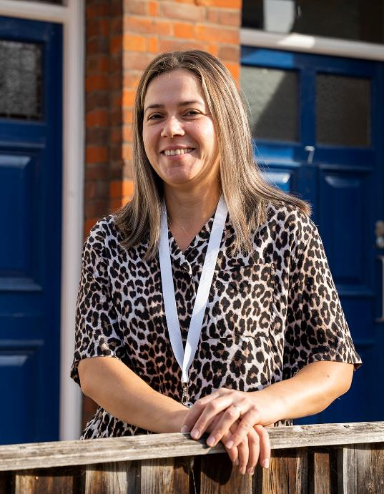
Pastoral Care
Team of House Parents and Personal Tutors who meet with students weekly
Support any concerns
Wellbeing sessions
Assistance with medical needs and registration with GP
Book medical, dental, optician or counselling appointments
Available to talk to at any time
Liaise with teaching staff
Monthly newsletter on topics relating to health and wellbeing
18

Slide 20
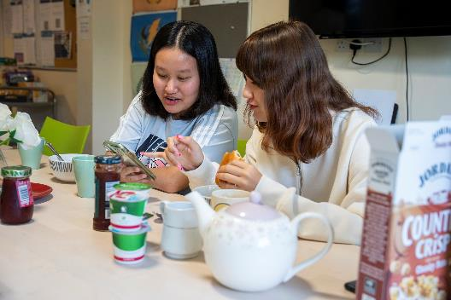
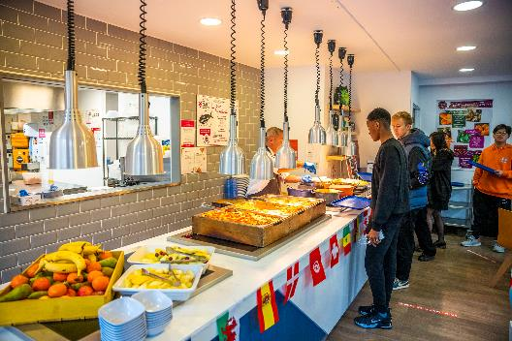
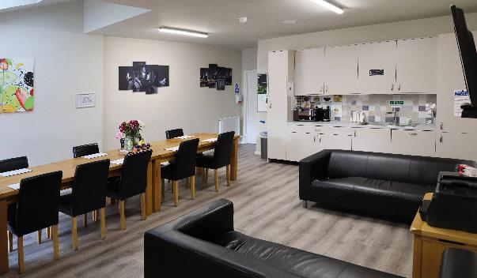
Accommodation
Six boarding houses with dedicated House Parents
Breakfast provided, evening meal at our canteen close by.
Comfortable family-style environment
Celebrate special occasions – birthdays, cultural and religious events and achievements with students
19

Slide 21



Accommodation
Single ensuite, twin ensuite, single with shower and twin with shower options available
Cost-effective homestay accommodation available for students aged 16 or over who want to live as part of a family and experience English family life
Homestay carefully selected by our accommodation team, regularly inspected and monitored
20

Slide 22
Scholarships
Generous scholarships on offer
Based on results in school reports and IELTS level
For scholarships over 50%, English and Maths scholarship tests and IELTS level taken into account
Up to 35% off tuition for students on all courses
Up to 75% off tuition for A-Level students
21

Slide 23
Admissions
Complete an application form and send with school report, passport and birth certificate
Pay application fee
Complete entry tests in Maths and English and arrange an interview
Application reviewed and offer made if successful
Accept place and pay deposit
Forward copy of IELTS
www.standrewscambridge.co.uk
22

Slide 24

Heading Text

